Slide 1

Reduced Order Models (ROMs) and RAVEN
RAVEN Workshop
Presenter: Andrea Alfonsi
IRUG 2016

Slide 2
Outline
Brief introduction on ROMs
Application examples of ROMs
ROMs and RAVEN
Available ROMs
RAVEN ROM workflow
Ensemble Modeling
RAVEN examples
Create ROMs
Perform sampling of ROMs
Statistical Analysis

Slide 3
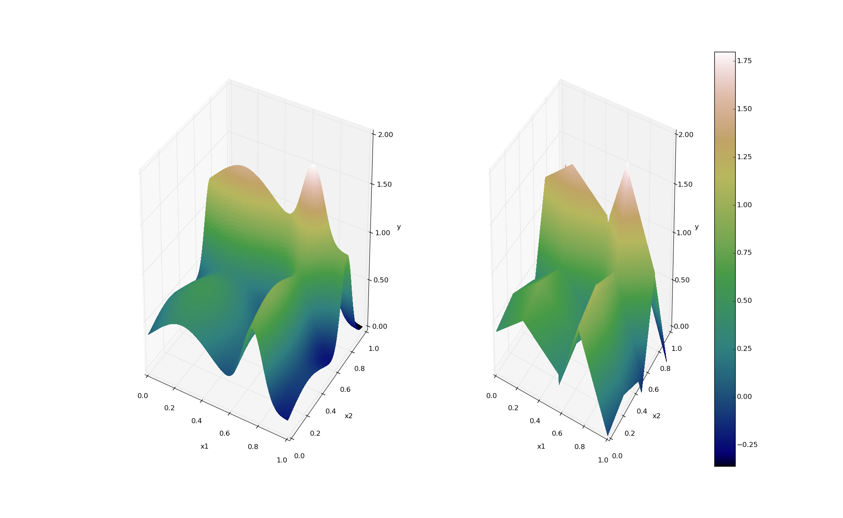
ROMs: a Quick Introduction
Output: Simulation outcome (success/failure, max clad temperature)
Consider a set of N data points
Build a surrogate model
Reduced Order Model
DataObjects
(PointSet)
Inputs: Initial and boundary conditions
≅

Slide 4
ROMs: a Quick Introduction
Basically we are trying to reduce the complexity of the original model
Pros:
Much faster computation of the output variables
Cons:
Possible presence of error in the ROM computed values
ROM (e.g., quadratic regressor)
≅
Original data (e.g., RELAP5)

Slide 5
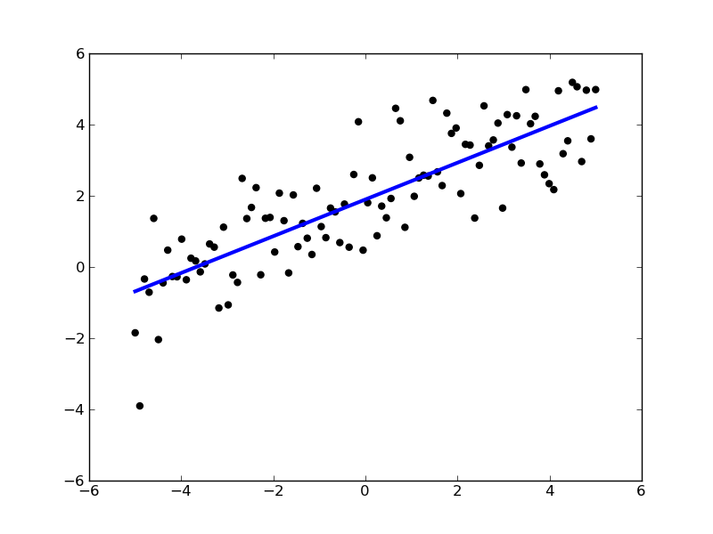
ROMs: Applications
Basic steps:
Sample original model
Train the ROM
Perform desired analysis with the ROM
instead of the original model
Range of applications:
Uncertainty quantification / Sensitivity analysis
Probabilistic Risk Analysis (PRA)
Accelerator for stochastic analysis (adaptive sampling)
Prediction models
Output y
Input x

Slide 6
ROMs Available in RAVEN
External libraries: Scikit-learn (http://scikit-learn.org)
Classification
Regression
Data clustering
Dimensionality reduction
Data pre-processing
Internally C++ developed libraries: CROW
Generalized Polynomial Chaos
Multi-dimensional interpolators
ND Spline
ND Inverse-Weight

Slide 7

Scikit-Learn Library
Classification
Starting point: set of data points with labels
[features, class]_{i}
Objective: identify which class a new point [features] belong
Regression
Objective: estimate the relationships among variables via a statistical process
Outcome: coefficients of the reduced space (e.g., m and c for linear interpolator)
Notes:
Add backup slides for some algorithms GPM and SVM

Slide 8
Cross-Validation for assessing ROM validity
Take out some of the training set
Train on the remaining training set
Test on the excluded instances
Cross-validation
k-fold cross-validation
Dataset
Train
Test
Compute a score (e.g. R²)

Slide 9
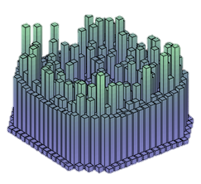
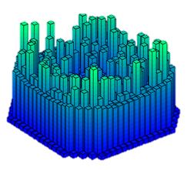
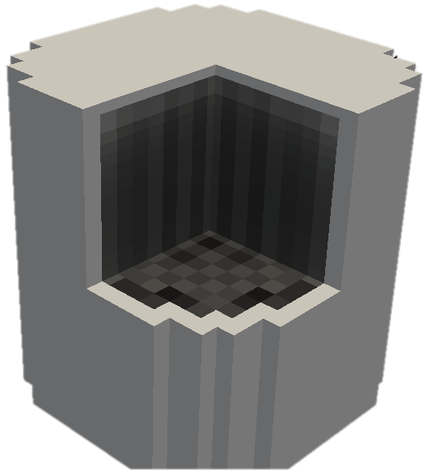
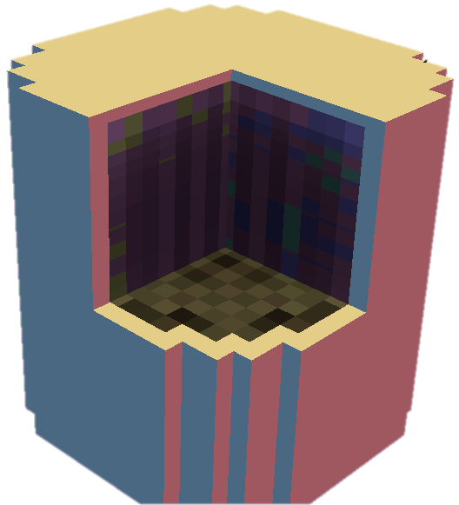
Ensemble Modeling Motivations
In several cases multiple models need to interface with each other since the initial conditions of some are dependent on the outcomes of others
In order to face this “problem” in the RAVEN framework, a new model category (e.g. class), named EnsambleModel, has been designed
This class is able to assemble multiple models of other categories (i.e. Code, External Model, ROM), identifying:
the input/output connections
the order of execution
the parallel execution strategy for each sub-model
Physics 1
EnsembleModel
Physics 2

Slide 10
Ensemble Model
Assemble multiple models of other categories, identifying the input/output connections and the order of execution
Common information transfer interface (RAVEN Data Objects)
Able to propagate both scalar and 1-Dimensional (e.g. time-series) info
Notes:
Sometimes, multiple models need to interface with each other since the initial conditions of some are dependent on the outcomes of others

Slide 11
Ensemble Model: Chain of Models
3 sub-models:
The Model 2 is connected with the Model 1 through the variable Θ (Model 1 output and Model 2 input)
The Model 3 is connected with the Model 2 through the variable Π (Model 2 output and Model 3 input)
Serial sequence
Model 1
Model 2
Model 3
Model 2
Multiple parallel execution
Model 1
Model 3
Notes:
Sometimes, multiple models need to interface with each other since the initial conditions of some are dependent on the outcomes of others.
Parallel execution, chain execution

Slide 12
RAVEN ensemble modeling example

Slide 13
Ensemble Model Time-dependent example
Hypothetical simplified PWR model:
EM1, A pump controller model for a hypothetical simplified PWR model has been used. It consists of Reactor core (RX), Motor operated pump, Pump digital controller and Heat exchanger (HX). This system is responsible to remove the decay heat generated from the core (RX) in order to avoid damage of the core itself.
EM2, A power history generator model has been used. It employs of the following simple equation:
Power(t) = 1,500*scaling_{P}*exp⁡(-t)

Slide 14
Ensemble Model Time-dependent example
Stochastic Parameters:
Pump controller failure time (CNTR_{f,time}):
Exponential Distribution, λ=0.00138889
Pump controller failure mode (CNTR_{f,mode}):
Categorical (0.33 each bin):
Mode 1: Failed Closed
Mode 2: Failed Stuck
Mode 3: Failed Random
Power multiplier (scaling_{P}):
Uniform between 0.5 and 1.5

Slide 15
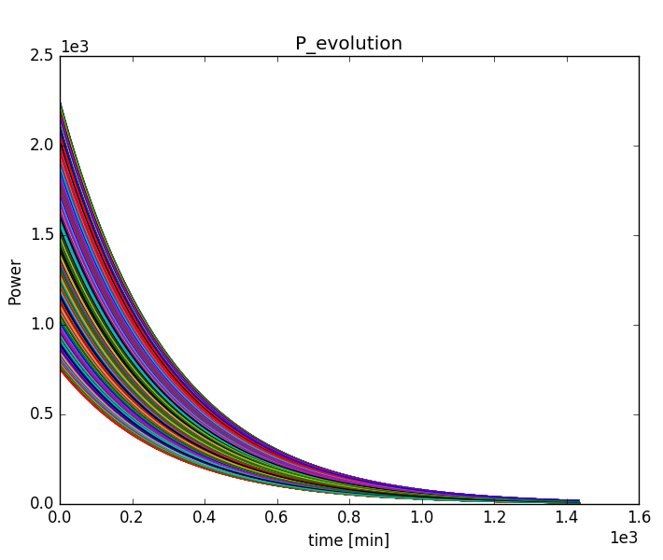
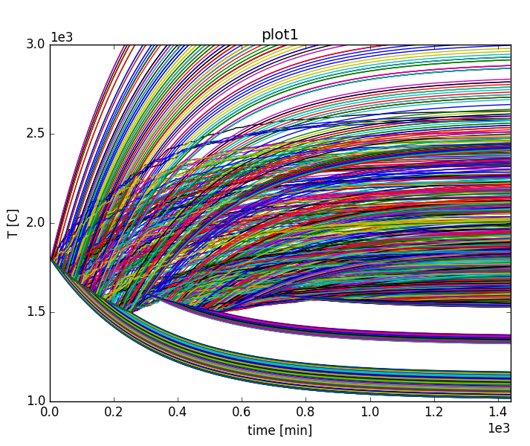
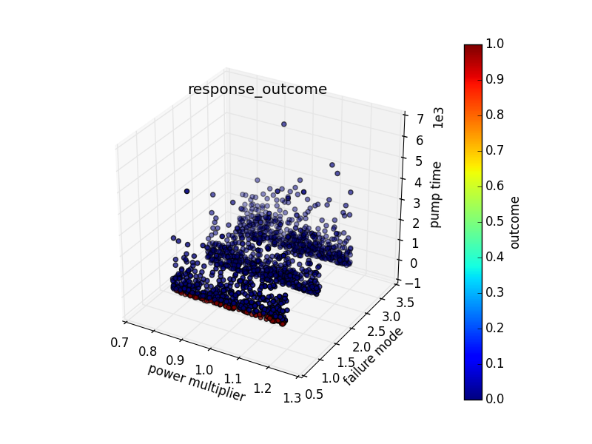
Ensemble Model Time-dependent example
Power(t)
Temperature(t)
Outcome
1500 Monte-Carlo samples
Most of the failures occur when the controller failed by sanding close signal to the pump
Notes:
1500 Monte-Carlo simulations
Most of the failures happened in failure mode 1 (i.e. controller failed by sending close signal to pump (i.e., pump not running)

Slide 16
ROM and Ensemble Modeling Within RAVEN
All modeling steps that involve ROMs are available in RAVEN
Create ROMs from a database
Perform statistical analysis using ROMs
Ensemble modeling

Slide 17
BWR SBO Scenario: Overview
Plant considered: BWR with Mk.I containment
Test case: Loss of Offsite Power (LOOP) + Loss of Diesel Generators
Objectives:
Evaluate impact of power uprate on LOOP+SBO accident scenario
Show capabilities of simulation based Probabilistic Risk Assessment (PRA) through RISMC

Slide 18
BWR SBO Scenario: Overview
Systems considered
Reactor Pressure Vessel (RPV) level control:
Reactor Core Isolation Cooling System (RCIC)
High Core Injection (HPCI)
RPV pressure control:
Safety Relief Valves (SRVs) including ADS
Containment:
Drywell (DW)
Suppression Pool (SP)
Reactor pump seal
Firewater injection system
Operators
Power Systems
Battery systems (DC systems)
Normal and emergency AC Power systems:
Power-grid
DGs

Slide 19
BWR SBO Scenario: Scenario Example
LOOP
Reactor trips
Main Steam Isolation Valves close
DGs successfully start
DC power and associated buses are available
DC power
extinguished
RPV
depressurization
Firewater Injection
Seal LOCA
Loss of DGs: SBO condition
RPV Pressure control: SRV
RPV Level control : RCIC (or HPCI)
Containment control (drywell and suppression pool)
AC recovery
RHR activation
Notes:
Scenario: LOOP + loss of DGs
Initial event: LOOP with successful reactor trip
DG failure occurs randomly after that
At this point (SBO conditions), operators maintain pressure and level control in RPV and suppression pool until limits are reached
cooling is provided by RCIC/HPCI (mid figure); pressure control provided by SRV (left figure).
Due to loss of cooling, pump seals may deteriorate leading to leaks in the drywell and thus reaching RPV depressurization point more quickly
3 recovery strategies: off-site power recovery, DG recovery, FW activation
After loss of DGs, Torus pool temperature increases at each SRV activation (right figure).
When pool TH limits are reached, the RPV is depressurized; no cooling can be provided other than FW if available
When RPV is depressurized, FW can be considered a recovery action even though it would compromise plant

Slide 20
BWR SBO Scenario: Stochastic Parameters
Stochastic parameters
Failure time of DGs
Recovery time of DGs
Battery life
SRVs fails open time
Offsite AC power recovery
Clad Fail temperature
HPCI fails to run
RCIC fails to run
Firewater availability time
Extended ECCS operation
Manual ADS activation

Slide 21
Workflow
Sample RELAP5 model Create database
Train a ROM
Sample ROM
Statistical Analysis

Slide 22
Sample RELAP5 model Create database
Train a ROM
Sample ROM
Statistical Analysis

Slide 23
1 – Sample a Model to create a database
Distributions
Models
Samplers
Databases
DataObjects
Steps
<Distributions>
<Uniform name=’DGrecDist'>
<upperBound>28800</upperBound>
<lowerBound>0.0</lowerBound>
</Uniform>
<Uniform name=’DGrecDist'>
<upperBound>28800</upperBound>
<lowerBound>0.0</lowerBound>
</Uniform>
<!-- cont. →
</Distributions>
Lower and Upper bounds

Slide 24
1 – Sample a Model to create a database
Distributions
Models
Samplers
Databases
DataObjects
Steps
Code Interface Type
<Models>
<Code name=’MyRelap5' subType=’Relap5’>
<executable>path/to/relap5</executable>
<alias variable=”failureTemp”>0000503:1</alias>
</Code>
</Models>
Executable location and name
Alias to have a more readable variable naming

Slide 25
1 – Sample a Model to create a database
Distributions
Models
Samplers
Databases
DataObjects
Steps
<Samplers>
<Stratified name=’LHS_Sampler'>
<variable name='0000200:1'>
<distribution>DGfailDist</distribution>
<grid type='CDF’ construction='equal' steps='4000’>0.0 1.0</grid>
</variable>
<variable name='0000579:6'>
<distribution>DGrecDist</distribution>
<grid type='CDF’ construction='equal' steps='4000’>0.0 1.0</grid>
</variable>
<!-- cont. -->
</Stratified>
</Samplers>
<variable name>
<distribution>
<grid points>

Slide 26
1 – Sample a Model to create a database
Distributions
Models
Samplers
Databases
DataObjects
Steps
<Databases>
<HDF5 name=’LHS_MC_database’ readMode=’overwrite'/>
</Databases>
<DataObjects>
<PointSet name=’FinalConditions'>
<Input>
0000582,0000583,0000597,0000596,0000200,
0000579,0000578,0000575,20508701,20508801,
failureTemp,0000588
</Input>
<Output>
timeof_692,timeof_578,timeof_591,timeof_672,cntrlvar_67,timeof_679
</Output>
</PointSet>
</DataObjects>
Overwrite or open in read mode?

Slide 27
1 – Sample a Model to create a database
Distributions
Models
Samplers
Databases
DataObjects
Steps
<Steps>
<MultiRun name='FirstMRun'>
<Input class=’Files' type=‘' >X11.i</Input>
<Input class=’Files' type=‘' >tpfh2o</Input>
<Model class='Models' type=’Code’ >MyRelap</Model>
<Sampler class='Samplers' type=’Stratified' >Grid_function</Sampler>
<Output class='DataObjects’ type=’PointSet’ >FinalConditions</Output>
<Output class='Databases' type='HDF5' >LHS_MC_database</Output>
</MultiRun>
</Steps>
Model file
Step
Database
Model info
Sampler
DataObjects

Slide 28
Workflow
Sample RELAP5 model Create database
Train a ROM
Sample ROM
Statistical Analysis

Slide 29
2 – Train, Sample and perform SA on a ROM
Distributions
Models
Samplers
Databases
DataObjects
Steps
<Distributions>
<Uniform name=’DGrecDist'>
<upperBound>28800</upperBound>
<lowerBound>0.0</lowerBound>
</Uniform>
<Uniform name=’DGrecDist'>
<upperBound>28800</upperBound>
<lowerBound>0.0</lowerBound>
</Uniform>
<!-- cont. →
</Distributions>
Lower and Upper bounds

Slide 30
2 – Train, Sample and perform SA on a ROM
Distributions
Models
Samplers
Databases
DataObjects
Steps
<Models>
<ROM name=’SurrogateRELAP5' subType=’NDinvDistWeight'>
<Target>cntrlvar_67</Target>
<Features>
0000582,0000583,0000597,0000596,
0000200,0000579,0000578,0000575,
20508701,20508801,failureTemp,0000588
</Features>
<p>3</p>
</ROM>
<PostProcessor name=’stas' subType=’BasicStatistics’>
<what>all</what>
<parameters>
cntrlvar_67, 0000582,0000583,0000597,0000596,
0000200,0000579,0000578,0000575,
20508701,20508801,failureTemp,0000588
</parameters>
</PostProcessor >
</Models>
Multi-dimensional interpolator (CROW)
Coefficient
Which Statistical FOMs?
Which Parameters?

Slide 31
2 – Train, Sample and perform SA on a ROM
Distributions
Models
Samplers
Databases
DataObjects
Steps
<Samplers>
<Stratified name=’LHS_SamplerROM'>
<variable name='0000200:1'>
<distribution>DGfailDist</distribution>
<grid type='CDF’ construction='equal' steps=‘8000’>0.0 1.0</grid>
</variable>
<variable name='0000579:6'>
<distribution>DGrecDist</distribution>
<grid type='CDF’ construction='equal' steps=‘8000’>0.0 1.0</grid>
</variable>
<!-- cont. -->
</Stratified>
</Samplers>
Finer Grid:
8000 vs. 4000

Slide 32
2 – Train, Sample and perform SA on a ROM
Distributions
Models
Samplers
Databases
DataObjects
Steps
<Databases>
<HDF5 name=’LHS_MC_database’ readMode=’read’/>
</Databases>
<DataObjects>
<PointSet name=’trainingData'>
<Input>
0000582,0000583,0000597,0000596,0000200,
0000579,0000578,0000575,20508701,20508801,
failureTemp,0000588
</Input>
<Output>
cntrlvar_67
</Output>
</PointSet >
<PointSet name=’outputROM'>
<Input>0000582,0000583,0000597,0000596,0000200,0000579,0000578,
0000575,20508701,20508801,failureTemp,0000588</Input>
<Output>cntrlvar_67</Output>
</PointSet >
</DataObjects>
Database containing training set
Training DataObject
ROM generated DataObject

Slide 33
2 – Train, Sample and perform SA on a ROM
Distributions
Models
Samplers
Databases
DataObjects
Steps
<Steps>
<IOStep name='extract_data'>
<Input class='Databases' type='HDF5' >LHS_MC_Database</Input>
<Output class='DataObjects' type=’PointSet’ >trainingData</Output>
</IOStep>
<RomTrainer name='rom_trainer'>
<Input class='DataObjects' type=’PointSet’ >trainingData</Input>
<Output class='Models' type='ROM' >SurrogateRELAP5</Output>
</RomTrainer>
<MultiRun name=’RunRom4'>
<Input class='DataObjects’ type=’PointSet’ >Data</Input>
<Model class='Models' type=’ROM’ >SurrogateRELAP5</Model>
<Sampler class='Samplers' type=’Stratified' >LHS_SamplerROM</Sampler>
<Output class='DataObjects’ type='PointSet' >outputROM</Output>
</MultiRun>
<PostProcess name=’statistics'>
<Input class='DataObjects’ type=’PointSet’ >outputROM</Input>
<Model class='Models' type=’PostProcess’ >stats</Model>
<Output class=’Files’ type=‘' >outputROM_stats.csv</Output>
</MultiRun>
</Steps>

Slide 34
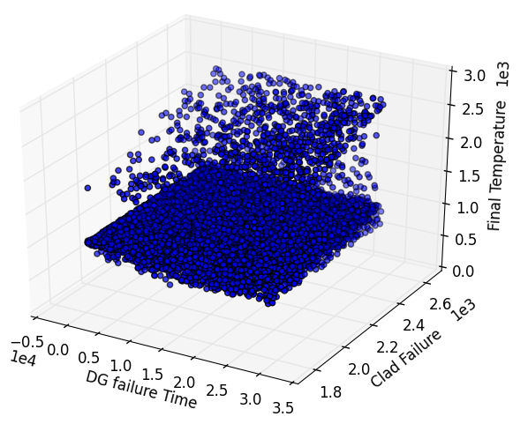
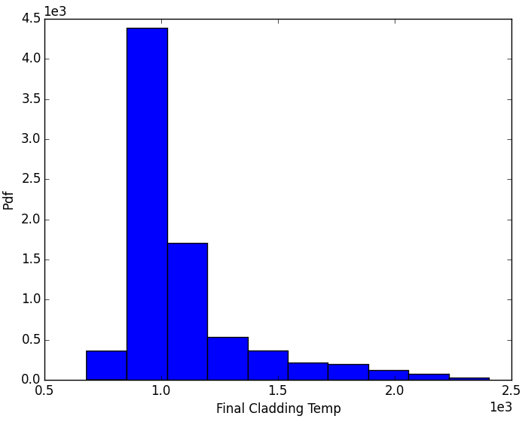
2 – Train, Sample and perform SA on a ROM
Computed Quantities | ROM | RELAP5-3D
Percentile 5% | 1.84E+03 | 1.84E+03
Percentile 95% | 2.56E+03 | 2.56E+03
Median | 2.20E+03 | 2.20E+03
Expected Value | 2.20E+03 | 2.20E+03
Variance | 5.33E+04 | 5.33E+04
Sigma | 2.31E+02 | 2.31E+02
Skewness | -2.38E-06 | -2.20E-06

Slide 35
3 – Ensemble modeling
Models
DataObjects
Steps
<Models>
<ROM name=’ROM1' subType='NDinvDistWeight'>
<Features>x1,x2</Features>
<Target>y1</Target>
</ROM>
<ROM name=’ROM2' subType='NDinvDistWeight'>
<Features>x1,x2,y1</Features>
<Target>y2</Target>
</ROM>
<EnsembleModel name=’together' subType=‘'>
<Model class='Models’ type=’ROM’>ROM1
<TargetEvaluation class=’DataObjects’type=’PointSet’>
ROM1Output
</TargetEvaluation>
</Model>
<Model class='Models’ type=’ROM’>ROM2
<TargetEvaluation class=’DataObjects’type=’PointSet’>
ROM2Output
</TargetEvaluation>
</Model>
</EnsembleModel>
</Models>
y1 is in:
ROM1 output space
ROM2 input space
This DataObjects define the in/out relations

Slide 36
3 – Ensemble modeling
Models
DataObjects
Steps
<DataObjects>
<PointSet name=’ outputROM1'>
<Input>x1,x2</Input>
<Output>y1</Output>
</PointSet >
<PointSet name=’outputROM2'>
<Input>x1,x2,y1</Input>
<Output>y2</Output>
</PointSet >
<PointSet name=’fullOutput'>
<Input>x1,x2</Input>
<Output>y2,y1</Output>
</PointSet >
</DataObjects>
Full Output

Slide 37
3 – Ensemble modeling
Models
DataObjects
Steps
<Steps>
<MultiRun name=’sampleEnsemble'>
<Input class='DataObjects’ type=’PointSet’ >Data</Input>
<Model class='Models' type=’EnsembleModel’>together</Model>
<Sampler class='Samplers' type=’Stratified' >LHS_SamplerEnsemb</Sampler>
<Output class='DataObjects’ type='PointSet' >fullOutput</Output>
</MultiRun>
</Steps>
Sample the EnsembleModel

Slide 38
Thank you Questions?

